Slide 1
Lending club’s loan repayment status Project – Final Report
DSCI 5240 Data Mining
Report Submission by Group 44,
Sruthi Galla (11478598)
Chirumamilla Tulasiram (11477281)
Vamsikrishna Velpuri (11457831)
Akash Vasanthan (11441194)
Sadik Shaik (11450878)

Slide 2
Project Contents:
Cover/Title
Executive summary
Project motivation/background
Data description
Data preparation activities
Models used
Findings
Managerial/business implications
Conclusions
References (if needed)

Slide 3
1. Cover/Title
We, Group 44 team have undertaken the project in data mining to perform analysis on the Lending club’s loan repayment status prediction data.
Our objective is to anticipate whether the loan is likely to default or not, based on the applicant's relevant information, in order to lessen the risk of loan default, which is a classification challenge. Logistic Regression would be ideal in this scenario because we are searching for whether or not the loan was defaulted on. The target independent variable "Loan status" was predicted using the dependent variables Loan Amount, Last Payment Amount, Debt-to-Income Ratio, and so on.

Slide 4
2. Executive summary
Lending Club is the world’s largest peer-to-peer lending company which lends unsecured debts, both fully funded loans and partially funded loans to the borrowers. It makes the decision of loan approval based on the information provided by the borrower and assigns a grade which determines the interest rate and fees. The lending club gets its profits from the interest amount paid by the borrower. Prediction of loan repayment plays a crucial role in the Loan approval prediction. As the lending club deals with so many loan applications per day it’s not easy to make decisions manually going through every information regarding every applicant whether to approve the loan or not and whether the loan would likely default or not. As Lending Club lends unsecured debts, it becomes even more important to accurately predict the credit-worthy applicant who can repay the loan without fail.
Prime goal of this project/report is to predict whether the borrower is going default or fully pay the loan amount, which is classification problem. We have carried out the analysis using the information provided by the borrower, Logistic Regression would perfectly fit in this case. The target variable here would be the “ Loan_status “, predicted using the independent variables such as Loan Amount, Interest Rate, Last Payment Amount, Debt-to-income ratio, purpose of loan etc.

Slide 5
3. Project motivation/background
As Lending Club makes its data publicly available, there are already analyses done on this dataset. First, we went through Lending Club’s website to know the actual process of loan approval to have a better idea about predicting the loan default. And then, we started with a preliminary research about the analysis of the dataset by downloading few research papers online and. According to the information on the website of Lending Club’s website, the loan approval is mainly based on minimum credit score 600, FICO score of 8, and Debt-to-Income ratio 35%-40%.
According to Analysis of Lending Club Data conducted by Stephen Owusu in 2019, The focus is on these 6 variables: the loan amounts, the loan status, Employment length, home ownership, the annual income, credit score. The analysis comes up with the conclusion, it would be more reliable to provide credit to customers who have worked for at least 3 years, have a B tier credit grade through visualizations and exploration. The company could decide that they would like to invest in B tier customers, who rent their homes and have been employed for more than 10 years to avoid the risk of loan defaults. Loans are less likely to get defaulted in case of the borrowers with lower interest rates (riskier) and smaller installments. This blog helped us understand and perform data cleaning and exploration better.

Slide 6
4. Data description
The dataset is a secondhand data set downloaded from the ‘Kaggle’. It gives the information about all loans issued through 2007-2015 by the Lending Club. The dataset contains 145 attributes and around 890,000 loan listings. The data contains information on all the loans issued by Lending Club updated every quarter on the same day as the quarterly results of the company are released. The dataset consists of information of all the details of the loan issues such as time of issuance, how much amount has been repaid so far, interest rate and the loan status.
As our dataset is very large with around 890,000 observations, we started exploring the dataset in excel sheet before importing into SASEM. We manually eliminated the columns with the missing values of 90% directly from excel and then imported the file in SASEM because the data import to SASEM resulted in run-time error due to insufficient memory. We considered a subset of data for import based on loan amounts $25,000-$35,000 and interest rate 14%-23% and then imported into SASEM which contains around 57,856 observations.

Slide 7
5.Data preparation activities
5(A). Dummy coding
As we are implementing a logistic regression model to predict the loan status, the target variable must be a binary variable. Our target variable loan_status_description is a nominal variable with 5 levels. We added a dummy variable for ‘loan_status_description’ as “loan_status” with the values ‘1’ where the loan status is current and late which can be interpreted as loan is not likely to default and with the values ‘0’ where the loan status is charged off and default which can be interpreted as loan is likely to default.
Verification status is a nominal variable with 3 levels i.e. verified, source verified and not verified. We dummy coded it as ‘1’ for verified and source verified and ‘0’ for not verified.
Application type is also a nominal variable with 2 levels which we dummy coded as ‘1’ for Individual and ‘0’ for joint.
Payment plan is also a nominal variable, which we dummy coded as ‘1’ for yes and ‘0’ for no.
For these 3 variables tot_coll_amt, tot_cur_bal, total_rev_hi_lim , we have imputed missing values with median value in the dataset (lc_loan).
Defining classes for loan status
Loan status | Description | Dummy Variable
Current | Loan is being repaid timely | 1
Charged off | When the loan is not paid for more than 150 days | 1
Fully paid | Loan amount paid fully | 1
Default | Loan is not paid for 120 days | 0
Late | Loan is being but after the due date | 0

Slide 8
5(B)Independent & Dependent Variable Description
Description of primary variables which are significant in prediction of the loan repayment status is given below and the description of all the variables used in the model is added in the appendix.
Dependent Variable:
Loan_status_description – Defines the status of the loan whether fully paid or defaulted. It is a nominal variable with 4 levels.
Loan_status - New dummy variable which defines the binary state of the loan_status description. It is a binary variable.
Independent Variables:
loan_amount – defines the amount requested by the borrower
last_paymnt_d – defines the last month payment received
dti – defines the debt-income ratio
annual_inc -annual income provided by the borrower
int_rate – interest rate
grade – grade given by lending club based in debt-income ratio and annual income

Slide 9
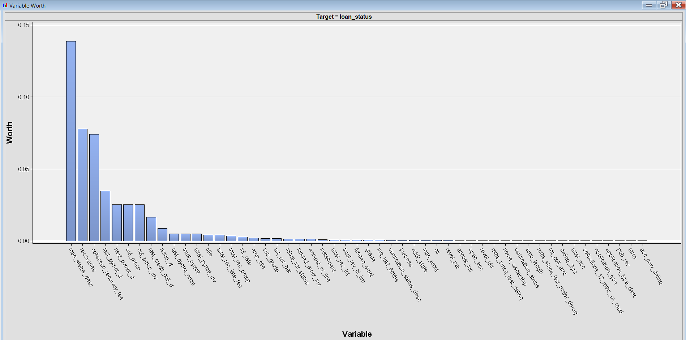
5(C). Data Cleaning & Exploratory Analysis
We explored all the variables using “StatExplore” node in SASEM to see which variables might have significance in predicting the target variable. Loan status description, and some variables which represent sum of the other independent variables have greater variable worth.
All these variables can be rejected because Sum of other independent variables is no longer an independent variable and loan status description is a nominal variable with more than 2 levels which is not used as we added a new binary variable loan status. Variable worth of the independent variables is shown in figure.
.

Slide 10
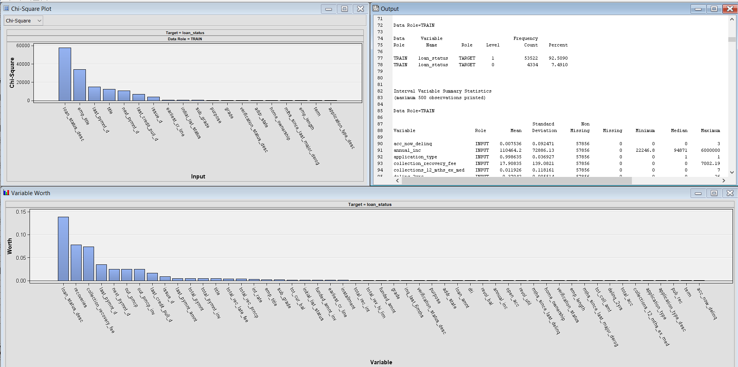
We partitioned Data into 55% of training data and 45% of validation data and test data is not assigned yet because the data is still in exploration phase as partitioning helps in managing the quality while fitting the regression model.
In SASEM, the regression model ignores the observations with missing values which results in lesser training data which might adversely affect the prediction of target variable. So, we manually imputed missing values with median.

Slide 11
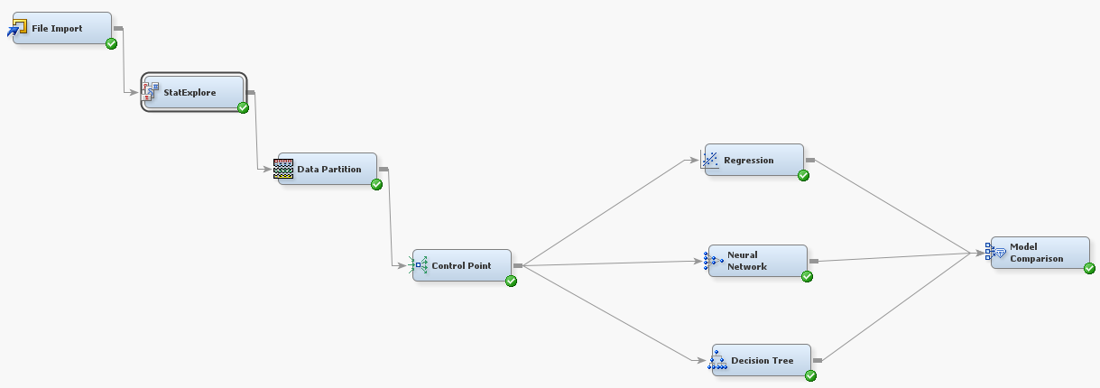
6. Models used
We are using three different predictive models- Logistic Regression, Decision tree and Neural network to predict the loan default status and comparing the results to see which model predicts the loan default rate better.
A “Control Point” is node is added to the variable selection node because it reduces the manual connections between multi data sources thereby simplifying the process flow diagram which are difficult read. It distributes connections internally to every node. We connected a “Regression” node, a “Decision Tree” node and a “Neural Network” node and then a “model comparison” node is connected to compare the results from the three models.

Slide 12
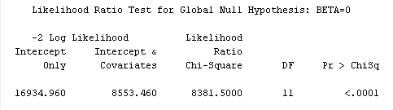
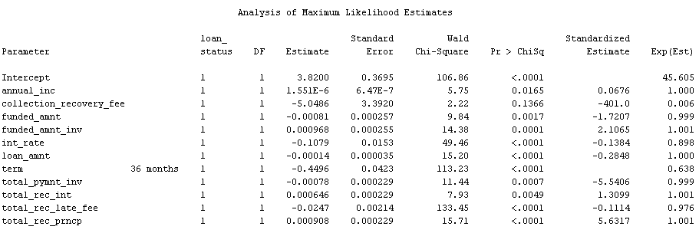
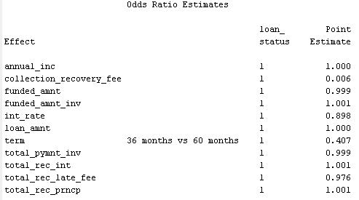
6(A). Logistic Regression
Collection fee post account is charged off, Debt to income ratio, last payment details, remaining principal amount, number of payments on the loan in the term, and number of public record bankruptcies are significant in predicting whether loan is likely to default or not.
The model is valid with p-value of chi squared less than 0.001 however chi square value is very large. Collection recovery fee has least odds of loan default.
Borrowers with less Debt-to-income ratio, and who paid their last payment and who made a greater number of payments in the term on the loan are less likely to have loan default.
Results from the SASEM output window such as likelihood ratio test, analysis of maximum likelihood estimates, and odds ratio estimates are shown below.

Slide 13
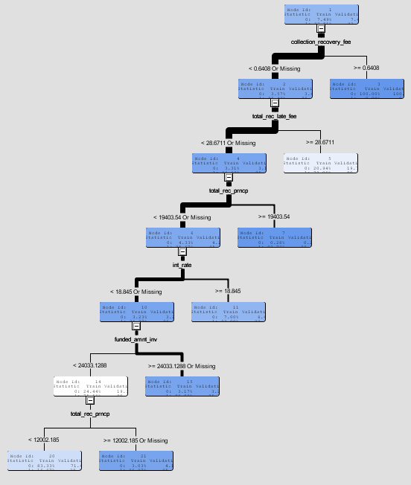
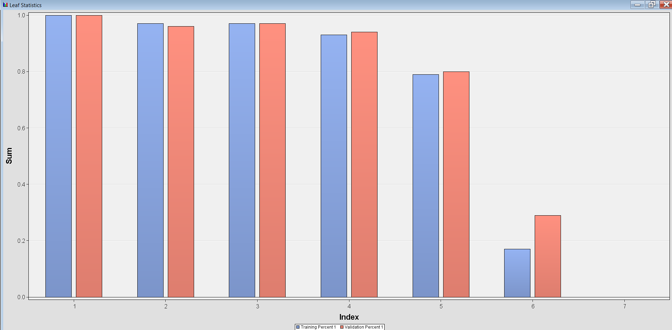
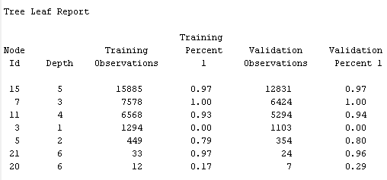
6(B). Decision Tree
Decision Trees build classification models in the form of tree structure. It contains decision nodes and leaf nodes. A decision node has two or more branches. Leaf node represents a classification or decision. The topmost decision node in a tree which corresponds to the best predictor called root node. Each branch denotes the outcome of the decision node, and each leaf node represents a class label.
In our scenario, the topmost node collection_recovery_fee is shown as the best predictor. The other significant predictors are total_rec_late_fee and total_rec_prncp. When we looked at the variables’ importance window, we could see independent variables which are important in predicting the loan default status. Results from the SASEM output window such as tree leaf report, and decision tree graph are shown below.

Slide 14
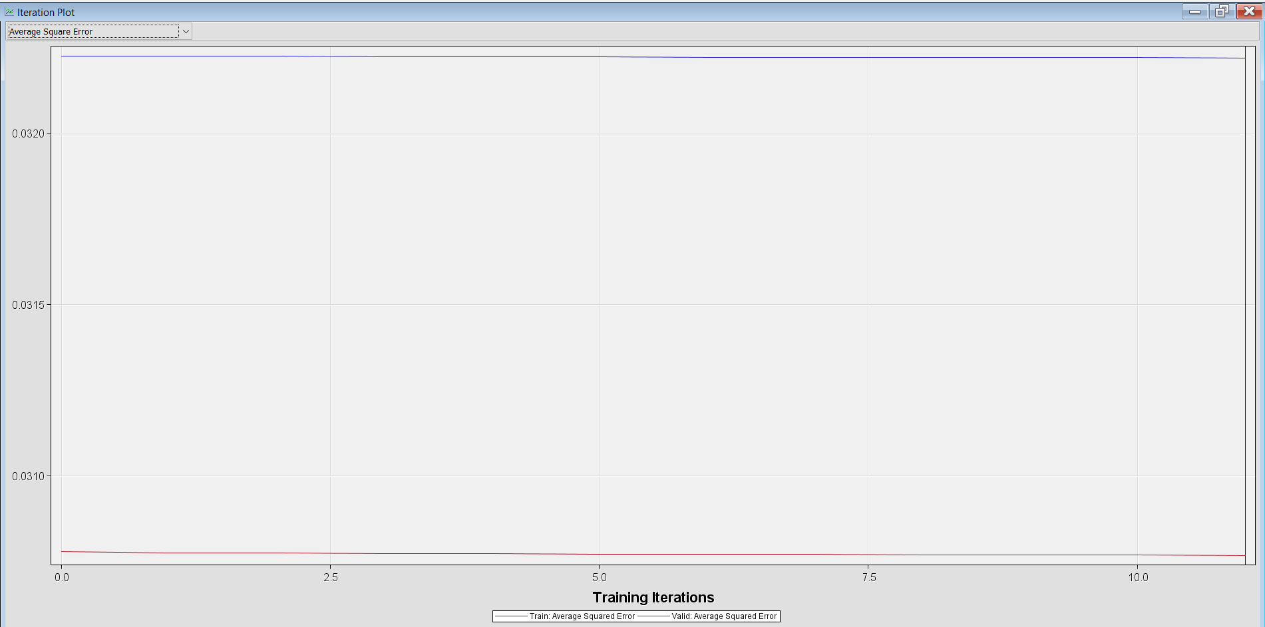
6(c). Neural Network Tree
Neural Network node, by default, is used to automatically construct a network that has one hidden layer consisting of three neurons. Neural networks can accommodate a wider variety of nonlinear relationships between a set of independent variables and a dependent variable than can logistic regression. Neural networks are so flexible.
In our scenario, we have not changed the default settings of SASEM: the architecture is selected as a Multilayer perceptron and set the number of hidden units to 3. When we explore the output window estimates of the variables and corresponding values of the gradient objective function are listed. The independent variables have a role in significantly predicting the dependent variable only if the value of the gradient objective function is positive. We have selected the rows from the output where the gradient value is positive which indicate that these independent variables will predict the loan status.
The rows are given in the table below. According to the results, int_rate, loan_amnt, funded_amnt_inv and total_rec_int are predicting whether a loan is likely to get default. SASEM result, average squared error plot is shown below.
Variable name | Estimate | Gradient Objective Function Value
int_rate | 0.022167 | 0.001000
loan_amnt | 0.177689 | 0.000484
funded_amnt_inv | 0.335611 | 0.000507
total_rec_int | 1.316114 | 0.000466

Slide 15
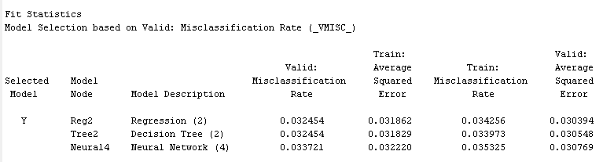
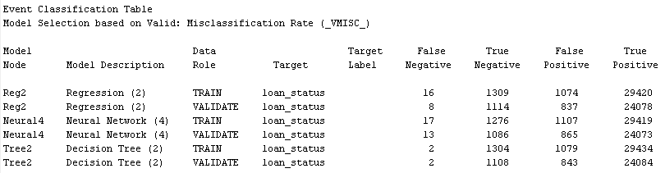
7. Findings
We have compared all the three models, Logistic Regression, Decision Tree and Neural Network discussed above, with respect to four statistics:
1). Average Squared Error 2). Misclassification rate 3). Area Under the Curve (ROC index) 4). F1 Score.
SASEM results from the model comparison node are shown below. From the fig. we could see that the decision tree has less average squared error and lowest misclassification rate. We have calculated F1 score for all models. To calculate F1 score, we need True Positive, False Positive, True Negative and False Negative values listed in the event classification tables listed in the output window. F1 score can be calculated from the formula given below. Event classification table is shown below.
Precision = TP / (TP+FP)
Recall = TP / (TP+FN)
F1 Score = 2 x (precision x recall / precision + recall)
High F1score indicates that the model is a good classifier. In this case, a clear decision tree with a high F1 score is the best model. Then we have observed the (ROC index) Area under the curve for all the three models. If we observe, the decision tree has more area under the curve which implies that the decision tree is the best model. If we consider all 4 metrics, the decision tree is the best model for predicting the loan status from the data sample we have taken. All The four statistics for the three models are summarized in the table below. The fit statistics and event classification tables are shown below.
Model | Average squared error | Misclassification rate | F1 score | ROC Index
Logistic Regression | 0.030394 | 0.032454 | 0.98275545 | 0.879
Decision Tree | 0.030548 | 0.032454 | 0.98275968 | 0.871
Neural Network | 0.030769 | 0.033721 | 0.98209041 | 0.896

Slide 16
8. Managerial/business implications
We current project approach can be utilized in the real business world to predict the borrower is going default or fully pay the loan amount.
Our approach is beneficial to banking and other finance institutes to know their net worth customers and nonperforming assets (NPAs) with respect to loan amount.
By consideration the various features, the lending institutions can minimize their defaulters and thereby enhance their business with maintaining loyal customer base.

Slide 17
9. Conclusions
We explored statistical properties of every variable and dealt with missing values by replacing them with median values and standardized all variables and then implemented three predictive models : Logistic Regression, Decision Tree and Neural Network and compared the models’ statistics to find the best model which predicts the loan default status better among the three models.
The results of the three models were quite different in terms of predicting independent variables which significantly predict the dependent variable. We compared these models with respect to four statistics: Average squared error, misclassification rate, Area under the curve (ROC index) and F1 score and decision tree is proven to be the best model in predicting the loan default status with highest F1 score.

Slide 18
Appendix: Dataset Variables/Attributes Description and their roles and datatypes
Sr.No | Attributes | Description | Role | Datatype
1 | Purpose | Purpose of the loan | Default | Nominal
2 | last_pymnt_d | Last month payment was received | Default | Nominal
3 | annual_inc | Annual income of the borrower | Input | Ordinal
4 | loan_status | Status of the loan | Output | Interval
5 | home Ownership | Home ownership status (Car, house etc.) | Default | Nominal
6 | member_id | Member ID | Reject | Ordinal
7 | loan_amnt | the amount of loan requested | Input | Ordinal
8 | total_pymnt | Total Payments received | Default | Ordinal
9 | last_pymnt_amnt | Last total payment amount received | Default | Ordinal
10 | inq_last_6mnths | Number of credit inquiries | Default | Ordinal
11 | Dti | Debt-Income ratio | Input | Interval
12 | int_rate | Interest rate | Input | Nominal
13 | Grade | Grade | Default | Nominal
14 | Installment | Monthly Installment | Default | Ordinal
15 | verification Status | Income source verification | Default | Nominal
16 | Term | Loan Duration | Reject | Interval
17 | recoveries | Post charge off gross recovery | Default | Ordinal
18 | title | What for loan taken | Default | Nominal

Slide 19
10. References
https://www.wikipedia.org/
https://www.kaggle.com/
Lectures and slides of Dr. Russell Torres
https://www.google.com/
https://welcome.oda.sas.com/home

